Slide 1
Intro to Developing for the Kinect
Tommy Norman

Slide 2
Agenda
Introduction
Kinect Hardware Overview
Development Environment
Using the Camera
Depth Data
Skeletal Tracking
Speech Recognition
User Interaction
Other Demos
Resources

Slide 3

Things You Want to Know About Me But Are Afraid to Ask
Introduction

Slide 4

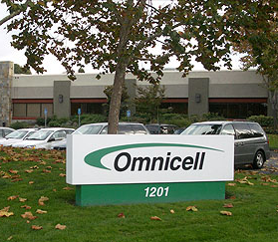



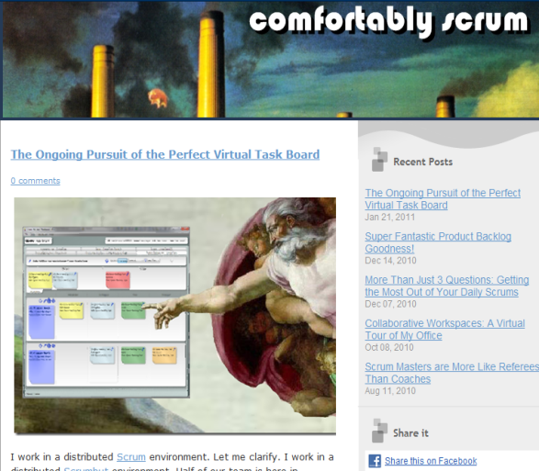

Tommy Norman
Omnicell
Scrum Master
ALM MVP
Blog
www.comfortablyscrum.com
Twitter
@tommynorman

Slide 5


Slide 6

I Am NOT a Kinect Expert!

Slide 7
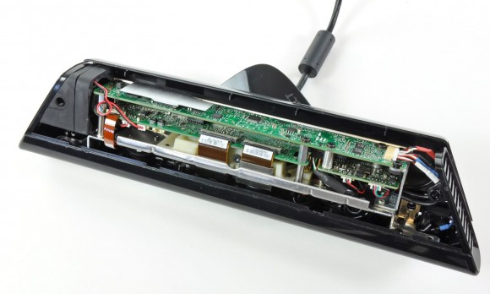
What The Heck Is In That Thing?
Kinect Hardware

Slide 8
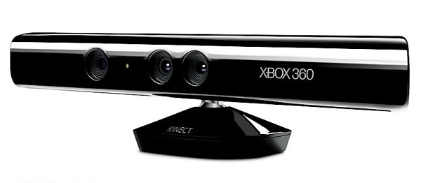
Regular Video Camera
640 x 480 Resolution
30 Frames Per Second
RGB Camera

Slide 9
Depth Sensor
Depth Projector
Infrared Projector
CMOS Sensor
Range ~2.5 - 13 Feet

Slide 10
4 Separate Microphones
Source Localization
Noise Suppression
Microphone Array

Slide 11
+/-27 Degree Range
NOT Meant For Frequent Use
Motorized Tilt

Slide 12
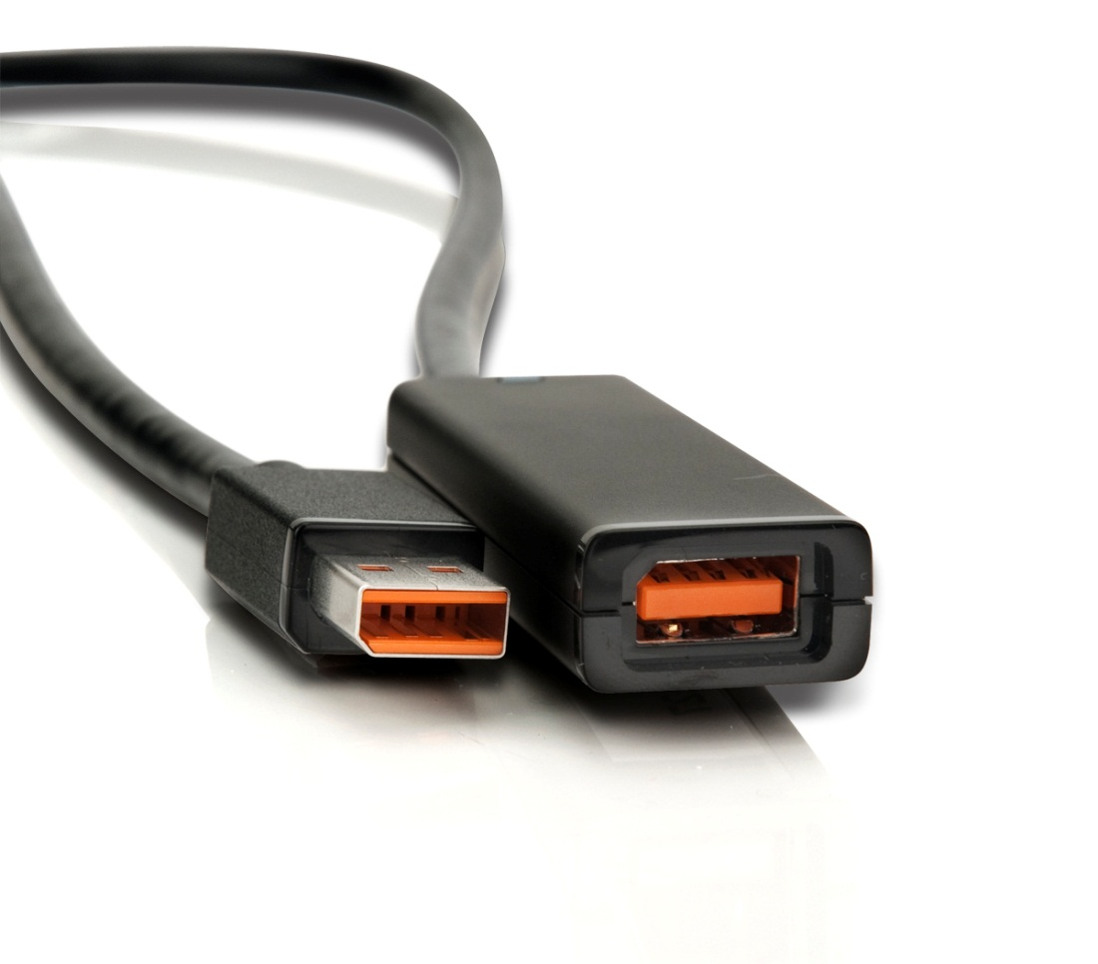
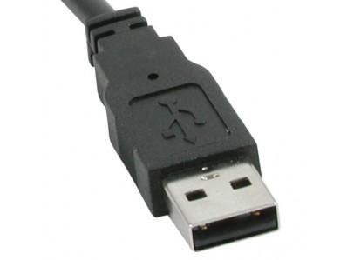
Kinect Cable Connection is NOT USB
USB
NOT USB

Slide 13
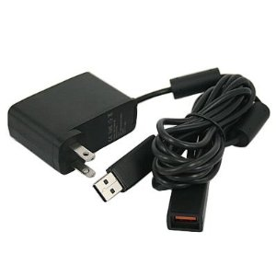
Kinect Cable Connection is NOT USB
http://www.amazon.com/Power-Supply-Cable-Kinect-Xbox-360/dp/B004S7GA46/ref=sr_1_1?ie=UTF8&qid=1330999990&sr=8-1

Slide 14
Kinect For Windows Vs. XBOX
“Near Mode” – As close as 40 cm (little over 1 ft.)
API Improvements
Licensing Mumbo Jumbo
An extra $100 bucks!

Slide 15
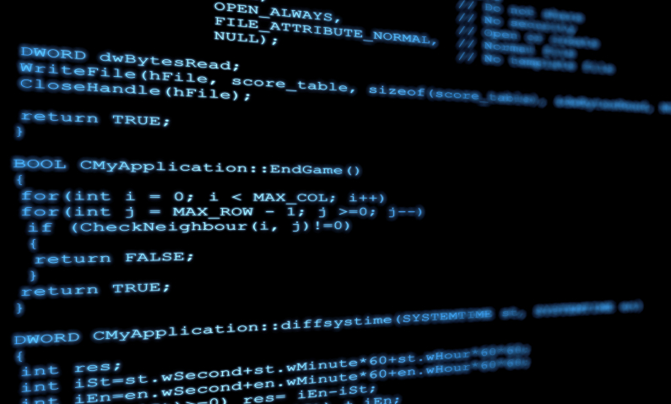
Gettin’ Da Kinect Hook Up
Development Environment

Slide 16
Downloads
Kinect SDK (link)
Microsoft Speech Platform - Server Runtime (link)
Microsoft Speech Platform SDK (link)
Kinect for Windows Runtime Language Pack (link)
Coding 4 Fun Kinect Toolkit (link)

Slide 17
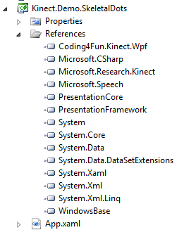
References

Slide 18
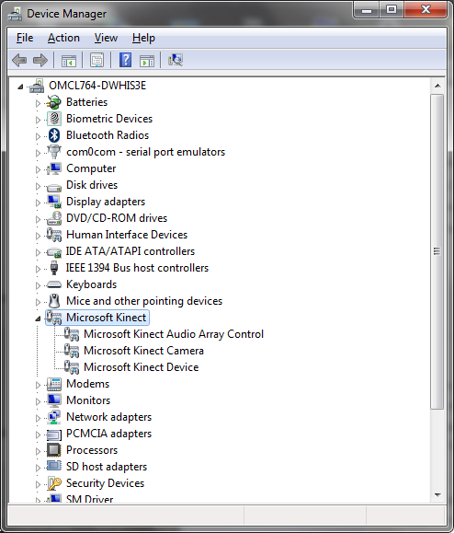
Connect the Kinect

Slide 19
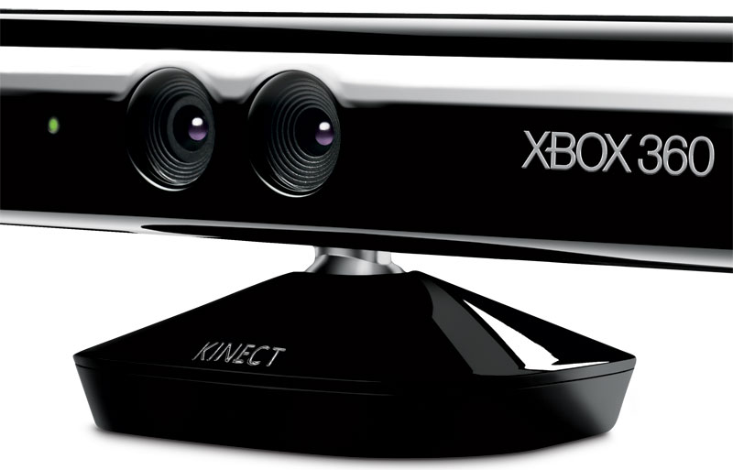
Say Cheese!
Using the Camera

Slide 20

Whoa, Dude. That was deep.
Depth Data

Slide 21
Depth Data
Raw Depth data is an array bytes (2 bytes/16 bits)
0,0
1
2
3
4
5
6
7
8
1
2
3
4
5
6
7
8
Player Index
Depth Measurements in Millimeters
(800 mm to 4000 mm)

Slide 22
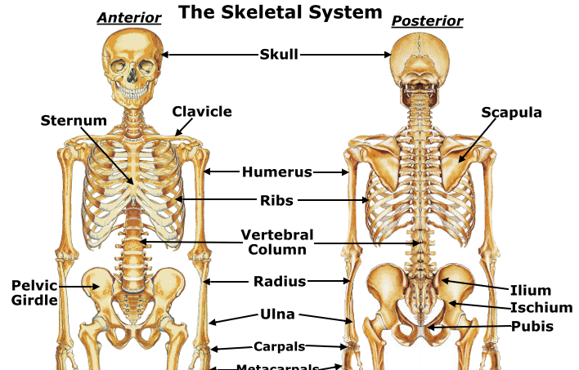
The Hip Bone’s Connected To The Leg Bone
Skeletal Tracking

Slide 23
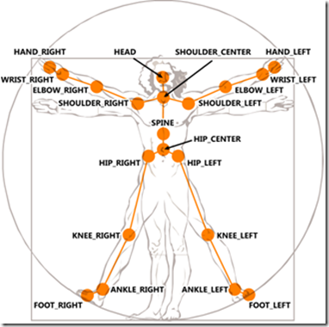
Skeleton Data
Collection of 20 Joints
X, Y, Z Axis
Tracking State
Tracked
Not Tracked
Inferred
Quality
Clipped Areas

Slide 24
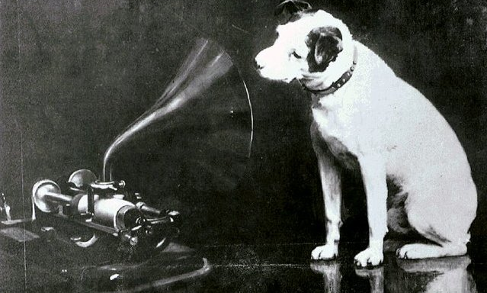
What You Say?
Speech Recognition

Slide 25

Oh, those pesky users!
User Interaction

Slide 26

This Is A Perfect Place For A Monkey
Other Demos

Slide 27
Real World Applications
Whole Foods (link)
Traumatic Rehabilitation Training(link)
Tiger Place (link)
Virtual Banking (link)
Virtual Dressing Room (link)
Controlling Robots (link)
Until the rise up and kill us all….

Slide 28
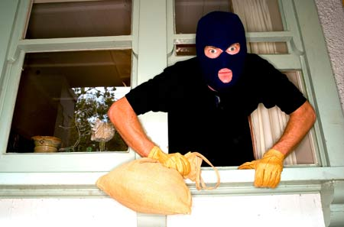
Places I Stole All This Crap From
Resources

Slide 29
Kinect Resources
Kinect for Windows – Main site, that’s about it. (link)
Channel 9 Quick Start Videos – The best place to start. (link)
Coding 4 Fun Kinect Blog – Lots of cool projects, most with code. (link)
Kinect Hacks – Tons of inspiring projects, not much code. (link)
How We Made it Work – This made my head hurt. (link)

Slide 30
Thank You!

